Slide 1



IPW Simulation
Department of Biostatistics and Bioinformatics,
Duke University
Feb 15, 2018

Slide 2
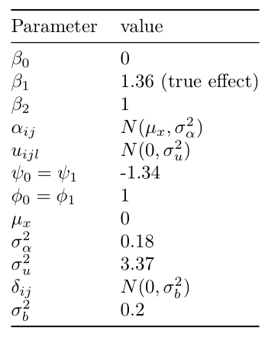

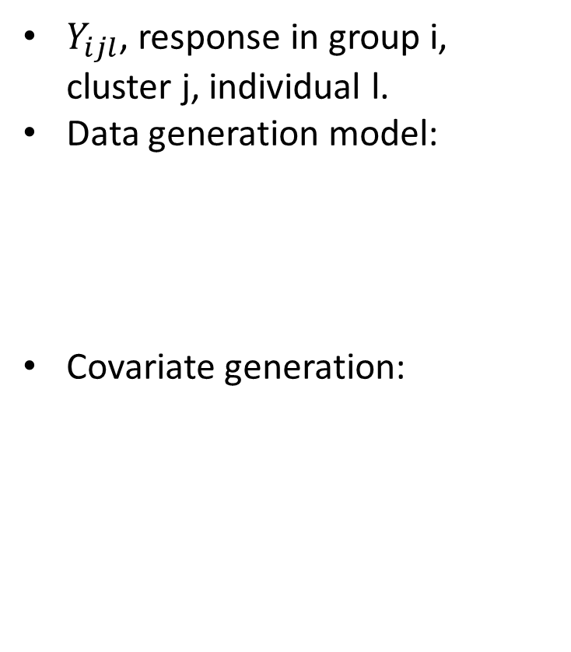



Covariates values
$Y_{ijl}$, response in group i, cluster j, individual l.
Data generation model:
Covariate generation:
$$π_{ijl}=expit(β_{0}+β_{1}i+f_{i}\left(X_{ijl}\right)+δ_{ij})$$
$$f_{i}\left(X_{ijl}\right)=β_{2}X_{ijl}$$
$$Y_{ijl} ∼Bin(1,π_{ijl})$$
$$X_{ijl}=α_{ijl}+u_{ijl}$$

Slide 3

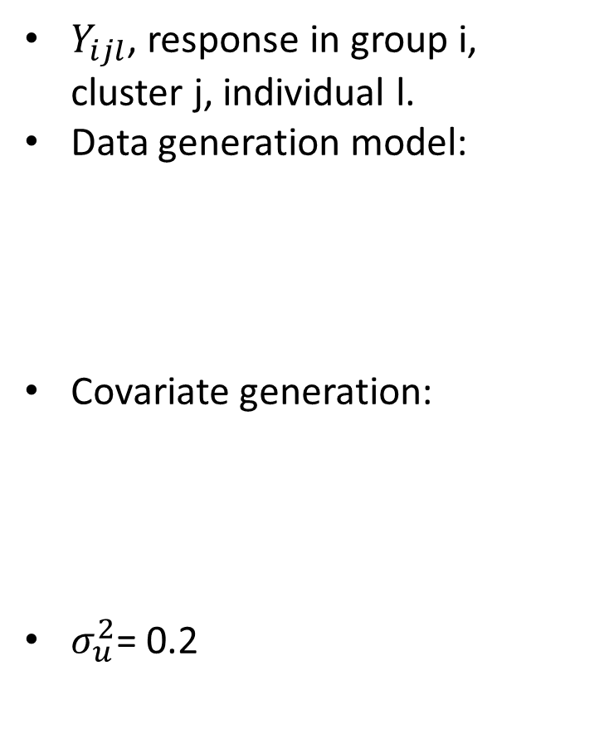

Covariates values
$Y_{ijl}$, response in group i, cluster j, individual l.
Data generation model:
Covariate generation:
$σ_{u}^{2}$= 0.2
$$π_{ijl}=expit(1+1.36 i+X_{ijl}+δ_{ij})$$
$$Y_{ijl} ∼Bin(1,π_{ijl})$$
$$X_{ijl}=α_{ijl}+u_{ijl}$$

Slide 4


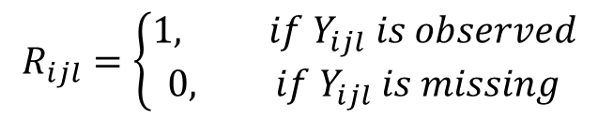


Covariates values
$$Missing Generation$$
$$R_{ijl}=\left\{\begin{aligned}1, if Y_{ijl} is observed \\ 0, if Y_{ijl} is missing\end{aligned}\right.$$
${logit(R}_{ijl}=0|Y_{ijl, }X_{ijl}$)=$ψ_{i}+φ_{i}X_{ijl}$+$θ_{ij}$
$θ_{ij}$calculated according to missingness ICC

Slide 5
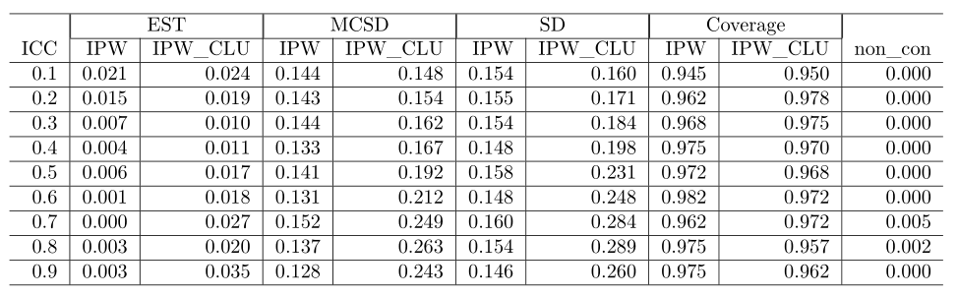

$$Missingness icc：0.1, 0.2, …0.9$$

Slide 6
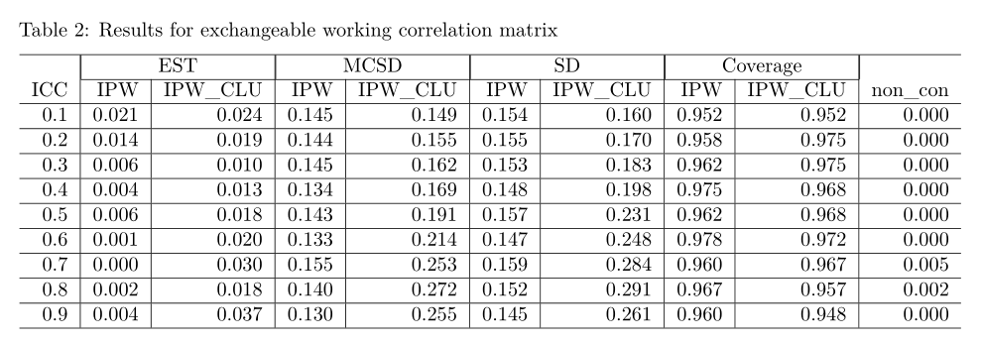
$$Missingness icc：0.1, 0.2, …0.9$$

Slide 7
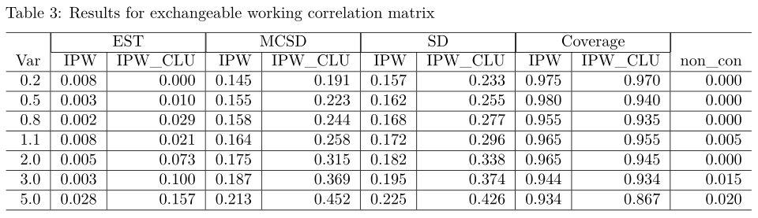
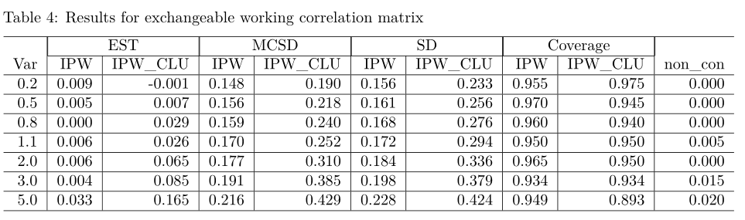


With different variances
$$X_{ijl}=α_{ijl}+u_{ijl}$$
$σ_{u}^{2}$= 0.2, 0.5, 0.8, 1.1, 2, 3, 5

Slide 8
Multiple imputation
 |  | Est | MCSD | SD | Coverage | Non
Independent | standard MI | 1.3417249 | 0.19788891 | 0.2505165 | 98.3 | 0
Independent | MMI | 1.3413689 | 0.19743583 | 0.2501361 | 98.8 | 11
Exchangeable | standard MI | 1.3414787 | 0.19731149 | 0.2494702 | 97.9 | 10
Exchangeable | MMI | 1.3417249 | 0.19788891 | 0.2505165 | 98.3 | 11

Slide 9
Thank You!

